Slide 1


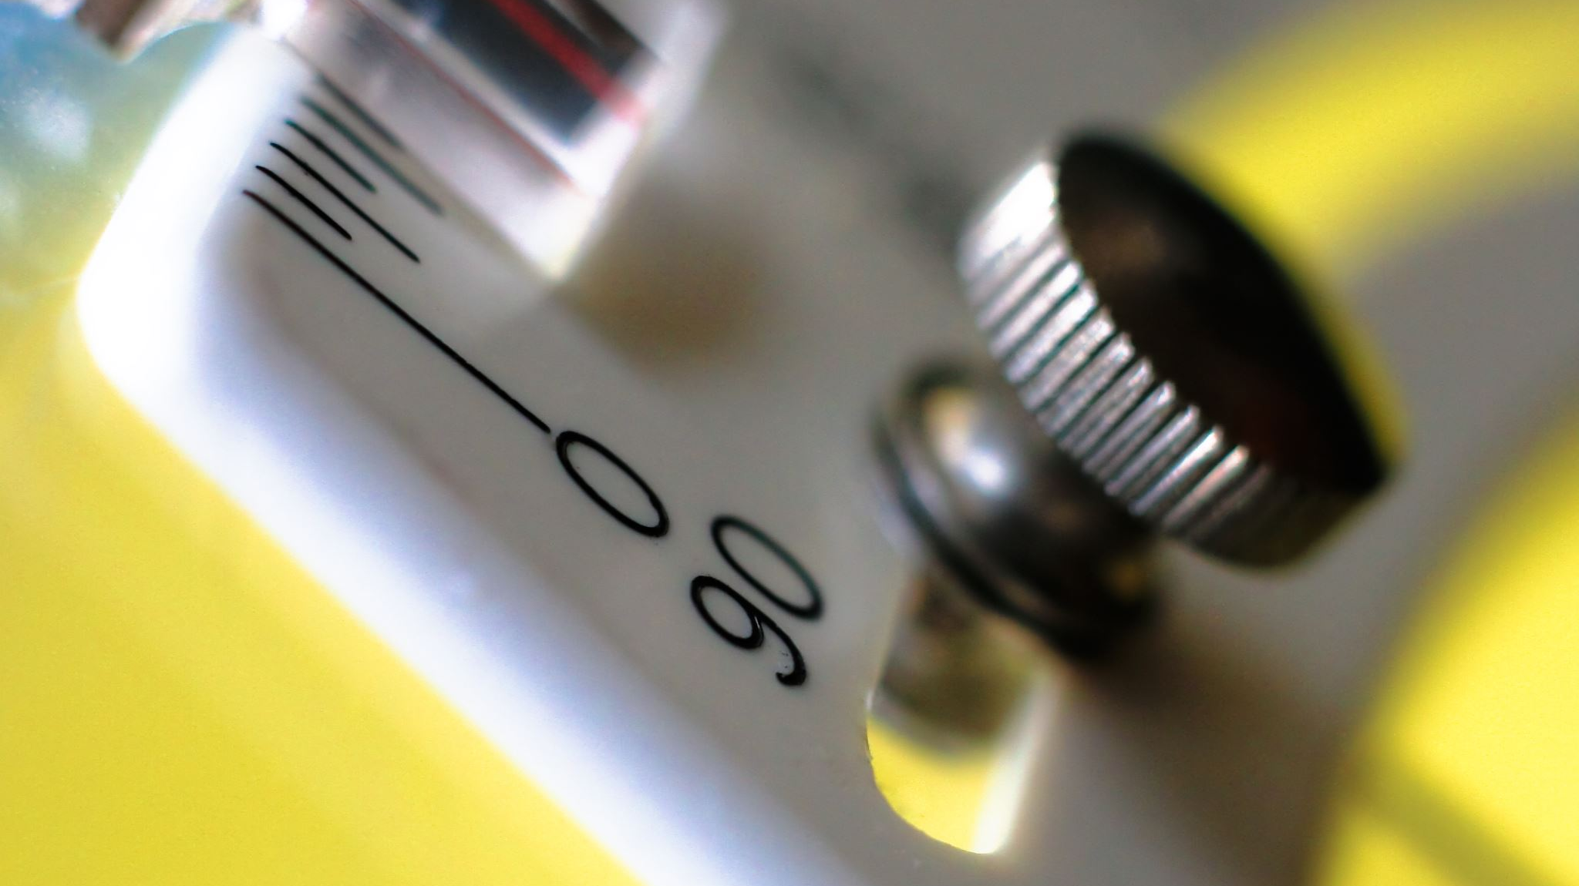
Water Level Indicator
Electronic devices lab

Slide 2

Group 3
Name | ID
Srabone Raxit | 21-45038-2
Ahnaf Abdullah Zayad | 21-45019-2
Irtiza Ahsan Abir | 21-45009-2
Mussa Alam | 21-45036-2
Ashik Ahamed | 21-45368-2

Slide 3
Introduction
The purpose of this project is to design and build a water level indicator electronic device that can detect the water level in a tank or reservoir and display the information to the user.

Slide 4
Background
Water level indicators are important in a variety of applications, such as agriculture, irrigation, and water supply systems. By providing real-time information about the water level, they help users to manage their water resources more efficiently.

Slide 5
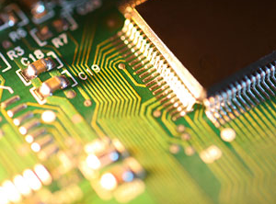
Apparatus:
DC547 Transistor
LED(Red, Green and Yellow)
Standard Bread Board
Buzzer
Resistor(47 kOhm, 100 Ohm)
Battery (9 volt)

Slide 6
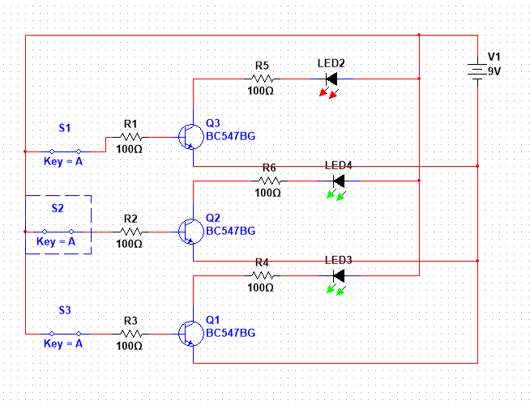
SIMULATION

Slide 7
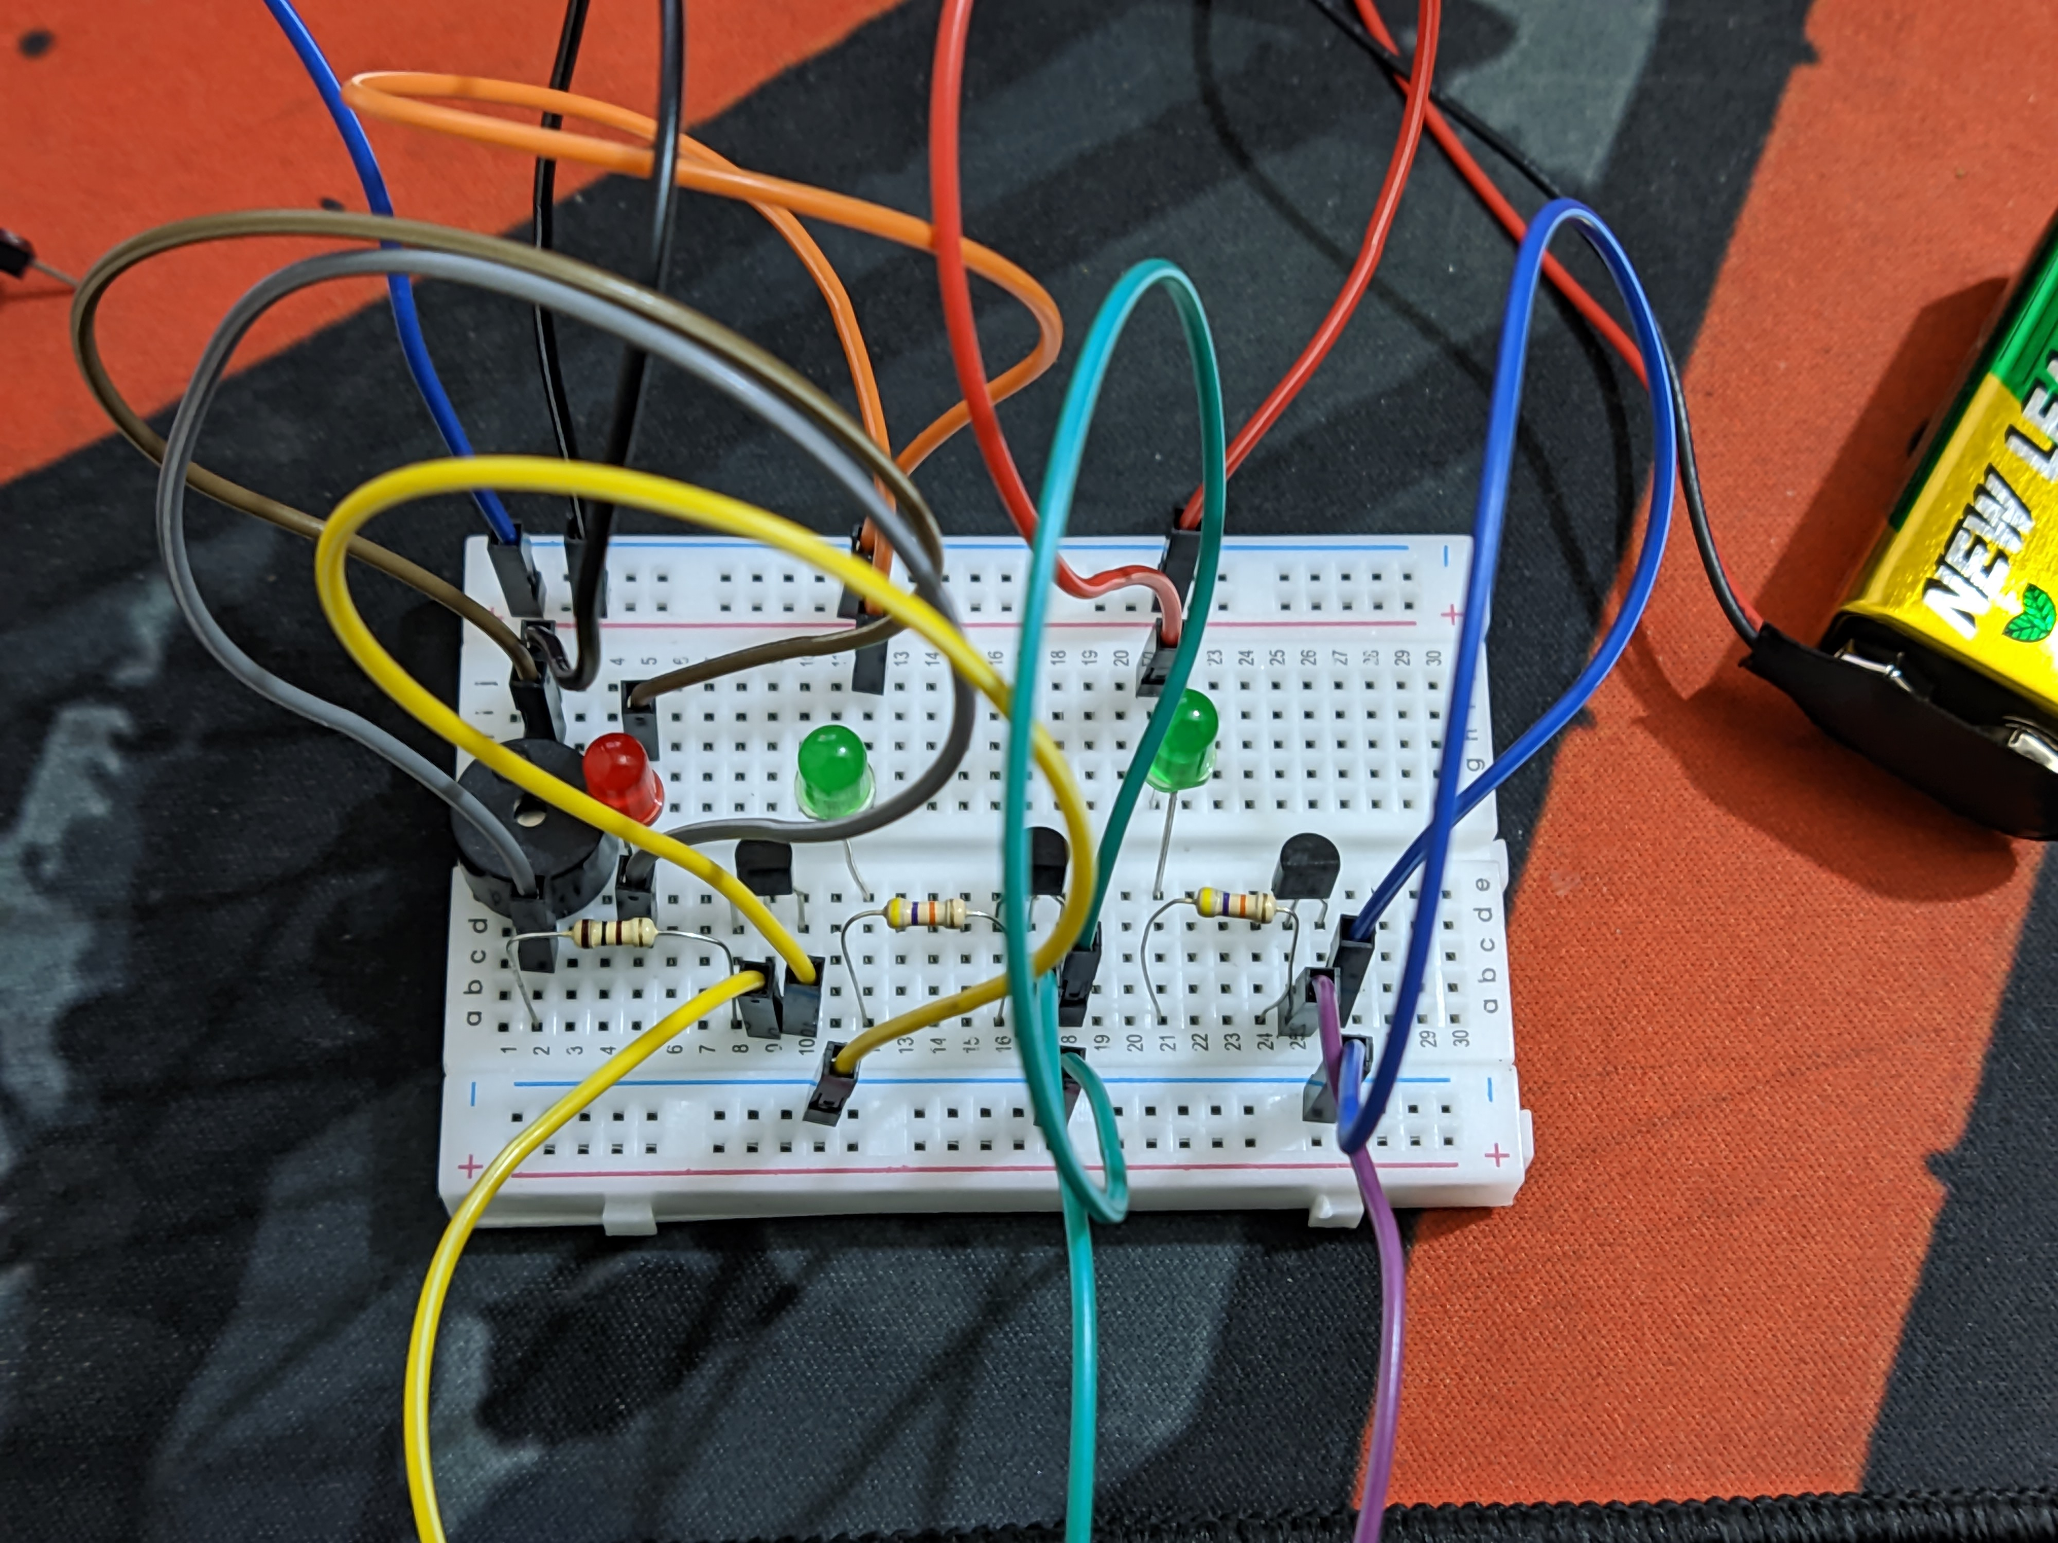
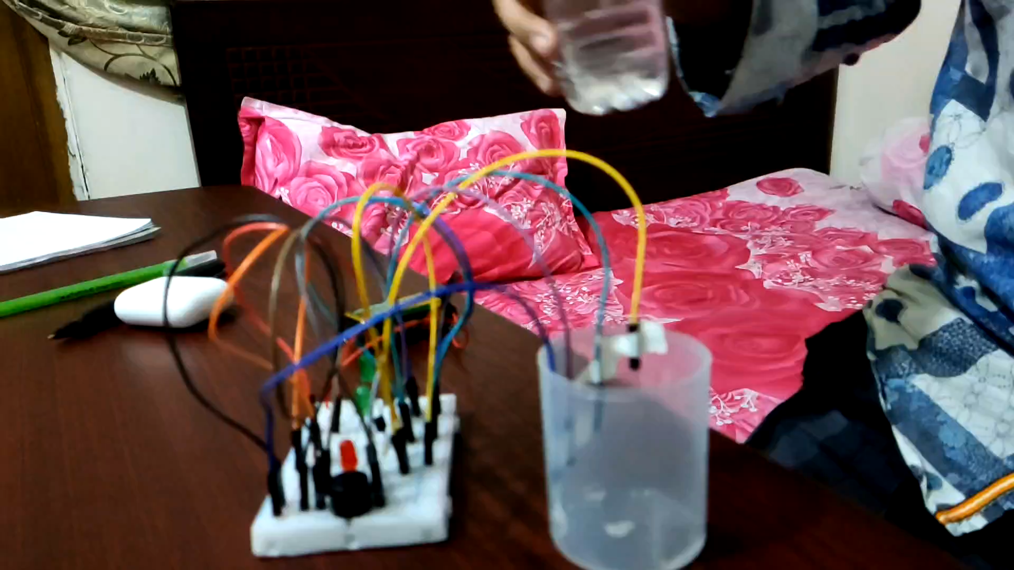
The PROJECT :

Slide 8
Working principle
The water level indicator works by using transistor to detect the water level in the tank or reservoir. The outputs are amplified and compared to a reference voltage, and the resulting signal is used to drive LEDs or a display to indicate the water level.

Slide 9
Future work
Future work on the water level indicator could involve adding additional features, such as wireless communication or remote monitoring. It could also involve optimizing the design for specific applications or environments.

Slide 10
Project IMPROVEMENTS
Matching wire with led
Adding motor to the circuit
Implementing auto-motor stop system

Slide 11
Conclusion
The water level indicator is a useful device that can help users to manage their water resources more efficiently. By providing real-time information about the water level, it can help to prevent overfilling or running out of water.

Slide 12
References
References used in the project may include books, articles, or online resources that were consulted during the design and construction of the water level indicator. of water.

Slide 13

Thank YOU

